Slide 1
numpy 1.18.1
import numpy
Vs
import numpy as np
Vs
from numpy import arrange
Vs
from numpy import *
Numpy : “Numeric Python” or “Numerical Python”.
pip install numpy
.npy file stores data, shape, dtype and other information required to reconstruct the ndarray in a disk file

Slide 2
import numpy as np
Vs
import numpy
There is no difference between the two but for simpler purpose we use,
import numpy as np
Instead of using numpy every time ,we are just renaming numpy as np so that it will be easier to call numpy functions wherever needed.
For example, If we need to reshape the array , we go for numpy’s reshape function
numpy.reshape(m,n)
where m and n are the number of rows and columns in the matrix.
import numpy as np
e = np.array([(1,2,3), (4,5,6)])
print(e)
e.reshape(3,2)

Slide 3
import numpy
e = numpy.array([(1,2,3), (4,5,6)])
print(e)
e.reshape(3,2)
Again we get the same output, From this we know that import numpy as np is used for our easier access of the numpy function, instead of typing the whole word numpy.reshape(m,n) we go for np.reshape(m,n)
Python does not have built-in support for Arrays

Slide 4
import numpy as np
Vs
from numpy import arange
If you want to use just one function say arange multiple times then it is advisable to use the first one because it will involve lesser typing compared to the second method where you have to type np.arange( ) every time.
However if you wanted to use multiple functions from the NumPy module then while using the first method you would have to write multiple import statements. And hence the second method is more appealing in such cases.

Slide 5
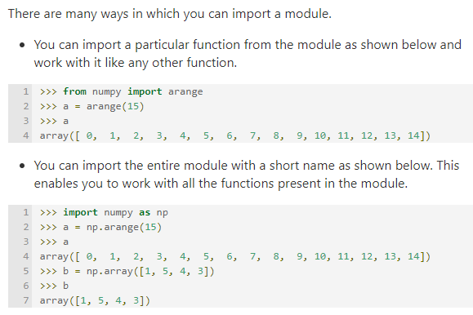

Slide 6
import numpy
Vs
from numpy import *
import numpy
numpy.array([1,2,3])
import numpy as np
np.array([1,2,3])
from numpy import *
array([1,2,3])
import numpy ------ imports numpy as numpy. You will need to first call numpy to executrsny method. Such as numpy.min. This is a good practice.
import numpy as np ------ is best practice.
from numpy import * ------ imports everything from numpy into global namespace. You wont need to type numpy.min, instead you just type min. This is not a good practice though, there is a chance that it will create a conflict with another method.
from numpy import * (you import every submodule in numpy and you do not need to call numpy again)

Slide 7
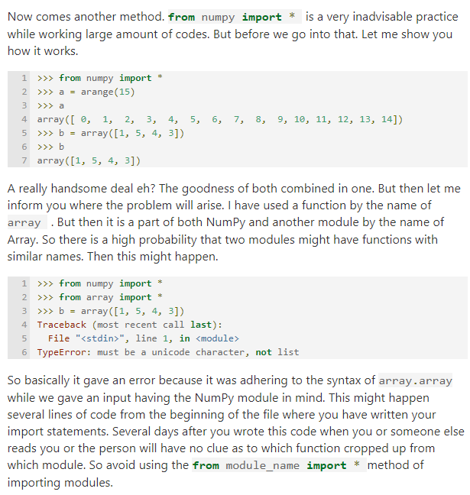
from numpy import * is a very inadvisable practice while working large amount of codes.
let me inform you where the problem will arise. I have used a function by the name of array. But then it is a part of both NumPy and another module by the name of Array. So there is a high probability that two modules might have functions with similar names. Then this might happen.

Slide 8
summarize some random functions and their numpy.random counterparts:
Note:
NumPy is specialized for building and manipulating large,
multidimensional arrays.
2. If you just need a single value, random will suffice and will probably
be faster as well.
3. For small sequences, random may even be faster too, because
NumPy does come with some overhead.
Python random Module | NumPy Counterpart | Use
random() | rand() | Random float in [0.0, 1.0)
randint(a, b) | random_integers() | Random integer in [a, b]
randrange(a, b[, step]) | randint() | Random integer in [a, b)
uniform(a, b) | uniform() | Random float in [a, b]
choice(seq) | choice() | Random element from seq
choices(seq, k=1) | choice() | Random k elements from seq with replacement
sample(population, k) | choice() with replace=False | Random k elements from seq without replacement
shuffle(x[, random]) | shuffle() | Shuffle the sequence x in place
normalvariate(mu, sigma) or gauss(mu, sigma) | normal() | Sample from a normal distribution with mean mu and standard deviation sigma

Slide 9
import numpy as np
Array = np.random.rand
Array = np.random.randn
Array = np.random.randint
Array = np.random.rand(10)
Array = np.random.rand(3,2)
Array = np.random.rand(3,3,3)
import random
from random import rand
from random import randn
from random import randint
from random import seed
from random import choice
from random import sample
from random import shuffle
from numpy import random
from numpy.random import rand
from numpy.random import randn
from numpy.random import randint
from numpy.random import seed
from numpy.random import shuffle

